Slide 1
cooking recipe prediction
P9120 Final Project
Guojing Wu (gw2383)

Slide 2
Introduction
Data
Methods
Results
Discussion

Slide 3
Introduction
What’s to cook tonight?
?

Slide 4
Introduction
What’s to cook tonight?
recipe
[ingredients]
Prediction
cuisine type

Slide 5
Introduction
Data
Methods
Results
Discussion

Slide 6
Data - Raw
Brazilian | British
cajun_creole | Chinese
Filipino | French
Greek | Indian
Irish | Italian
Jamaican | Japanese
Korean | Mexican
Moroccan | Russian
Southern_us | Spanish
Thai | Vietnamese
Train (N=39774)
id: INT
cuisine type: CHR
ingredients: LIST
unique
6714 unique ingredients
Test (N=9944)
id: INT
ingredients: LIST

Slide 7
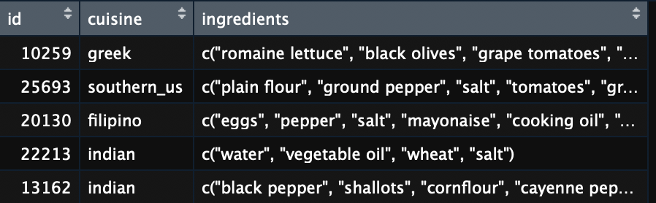
Data - Raw

Slide 8
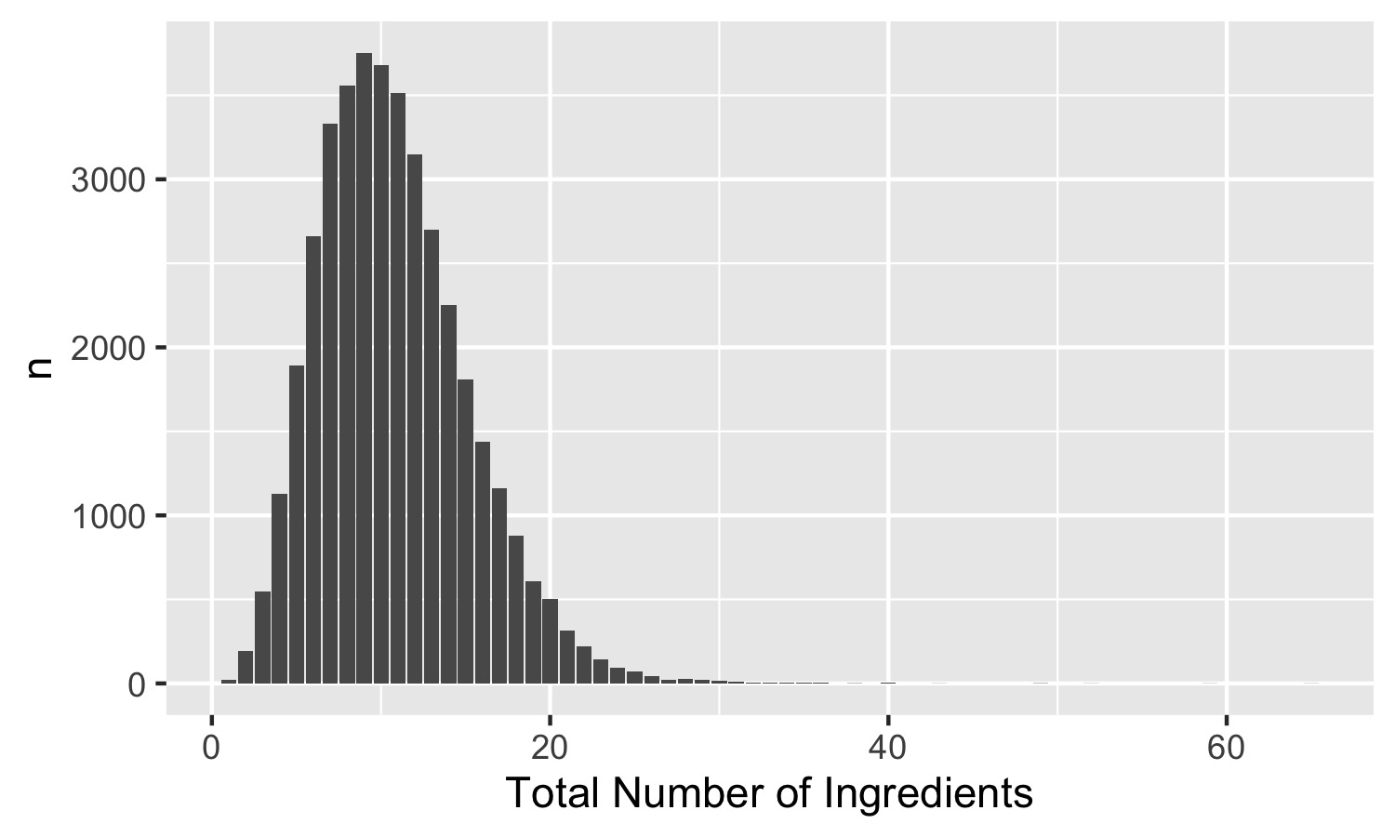
Data - EDA
Recipe length distribution

Slide 9
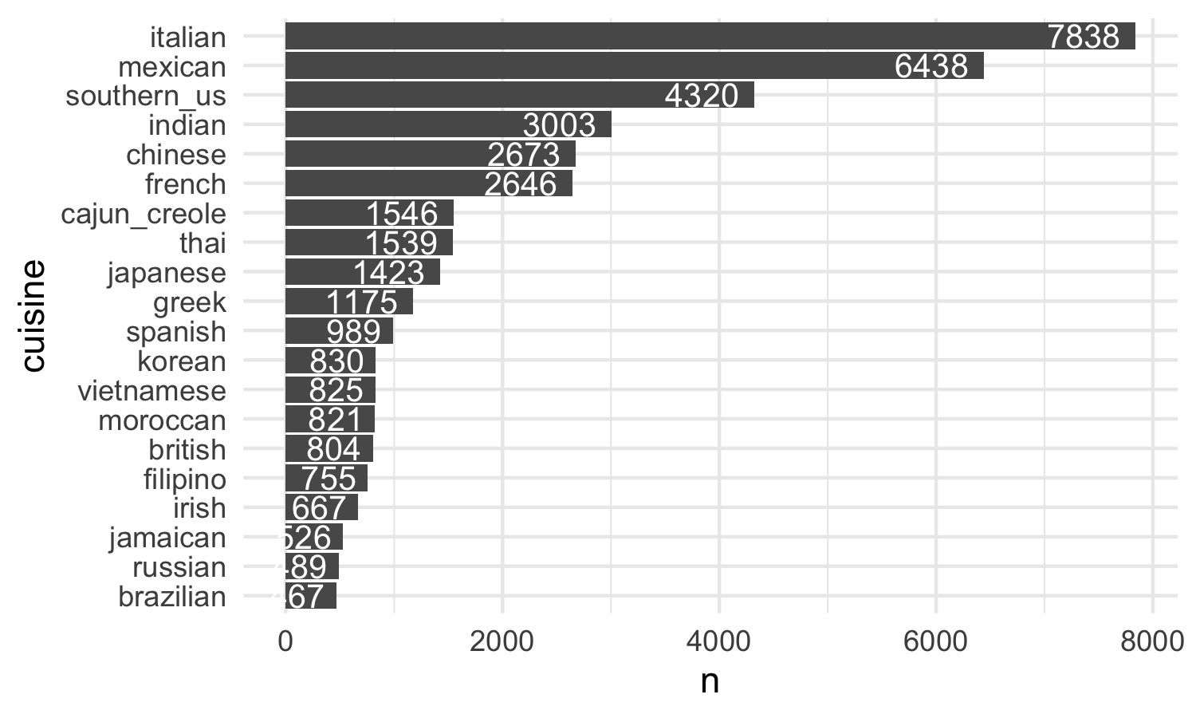
Data - EDA
Total number of recipes for each cuisine

Slide 10
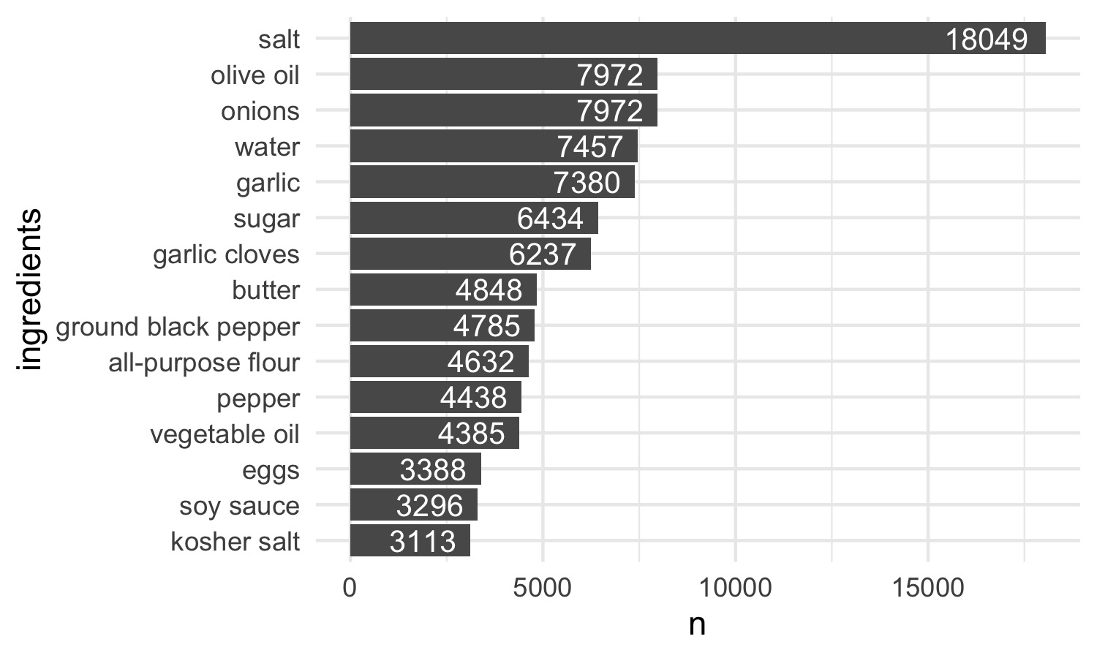
Data - EDA
Most common ingredients

Slide 11
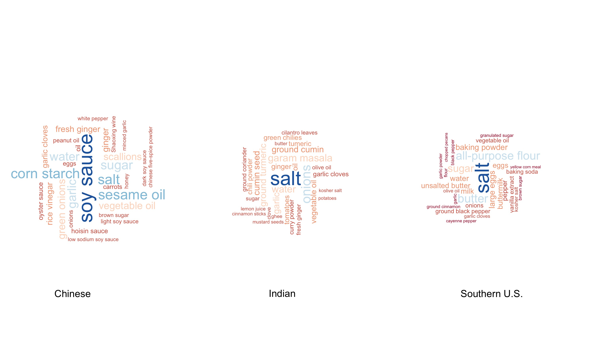
Data - EDA
Ingredients wordcloud

Slide 12
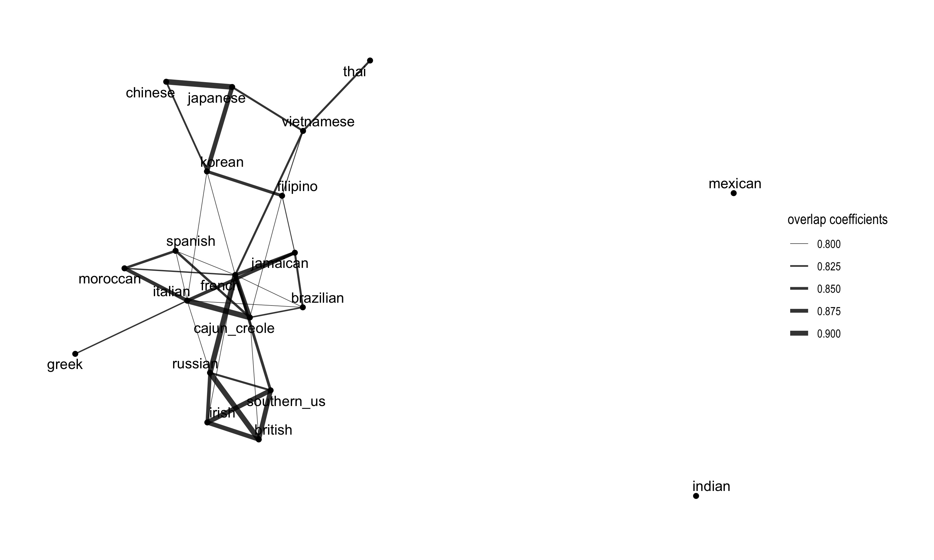
Data - EDA
Network graph

Slide 13
Data - EDA
Network graph

Slide 14
Introduction
Data
Methods
Results
Discussion

Slide 15
Methods
Feature
Extraction
Step1:
Step2:
Classification
Model

Slide 16
Methods – Feature Extraction
Train (N=39774)
6714 unique ingredients
id: INT
cuisine type: CHR
ingredients: LIST
6714 binary variables
0
[39774 x 6714]

Slide 17
Methods – Feature Extraction
Train (N=39774)
6714 unique ingredients
id: INT
cuisine type: CHR
ingredients: LIST
6714 binary variables
0
computationally expensive!
singularity!
[39774 x 6714]

Slide 18
Methods – Feature Extraction
Neural Word Embedding
Word2Vec
Term Frequency - Inverse Document Frequency
TF-IDF

Slide 19
Methods – Feature Extraction
Word2Vec
Neural Word Embedding
Word Embedding: vector representations of a particular word. It is capable of capturing context of a word in a document, semantic and syntactic similarity, relation with other words, etc.
Neural Word Embedding: a method to construct such an embedding, it uses a two-layer Neural Networks

Slide 20
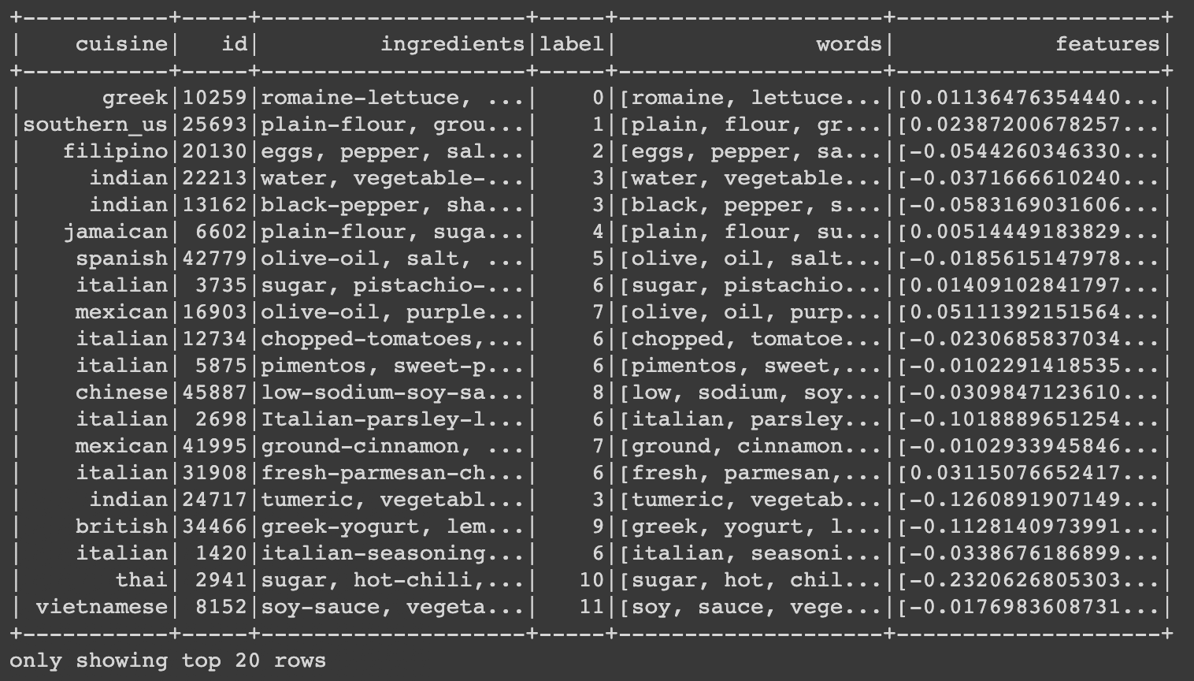
Methods – Feature Extraction
Word2Vec
Neural Word Embedding

Slide 21
Methods – Feature Extraction
Word2Vec
Neural Word Embedding
features=DenseVector([0.0114, -0.1702, -0.2332, 0.0414, -0.0933, -0.0583, -0.1135, 0.095, 0.1387, 0.0968, -0.2169, -0.0481, 0.071, -0.1068, -0.1895, 0.2072, 0.0295, 0.0662, 0.0819, -0.1132, 0.082, -0.1849, -0.0187, 0.0831, 0.0498, -0.0231, 0.0379, -0.0934, 0.0628, -0.1878, -0.03, -0.1295, 0.09, 0.1197, 0.0098, 0.0747, 0.1344, 0.1693, 0.0377, 0.0612, 0.1548, -0.0068, -0.0378, 0.0417, 0.0775, -0.0962, 0.0149, -0.2954, -0.0855, 0.0166, 0.0958, -0.0355, 0.1022, -0.1772, 0.1561, -0.0782, 0.1287, -0.1739, 0.0358, 0.0888, -0.0002, -0.032, -0.139, -0.1683, -0.1399, 0.0683, 0.0726, 0.0851, 0.0374, 0.0664, 0.0062, -0.1135, 0.0624, 0.2568, 0.0, -0.0275, 0.0274, 0.0497, 0.1231, 0.0324, -0.0426, -0.092, -0.0946, -0.0056, -0.0352, -0.0141, 0.1934, -0.0824, -0.0338, 0.1033, -0.0723, -0.1599, -0.0083, 0.0047, -0.1244, -0.0754, 0.0638, -0.0807, 0.1038, 0.0716])

Slide 22
Methods – Feature Extraction
TF-IDF
Term Frequency - Inverse Document Frequency
Term Frequency: number of times that words appear in a given document
Inverse Document Frequency: The more documents a word appears in, the less valuable that word is

Slide 23
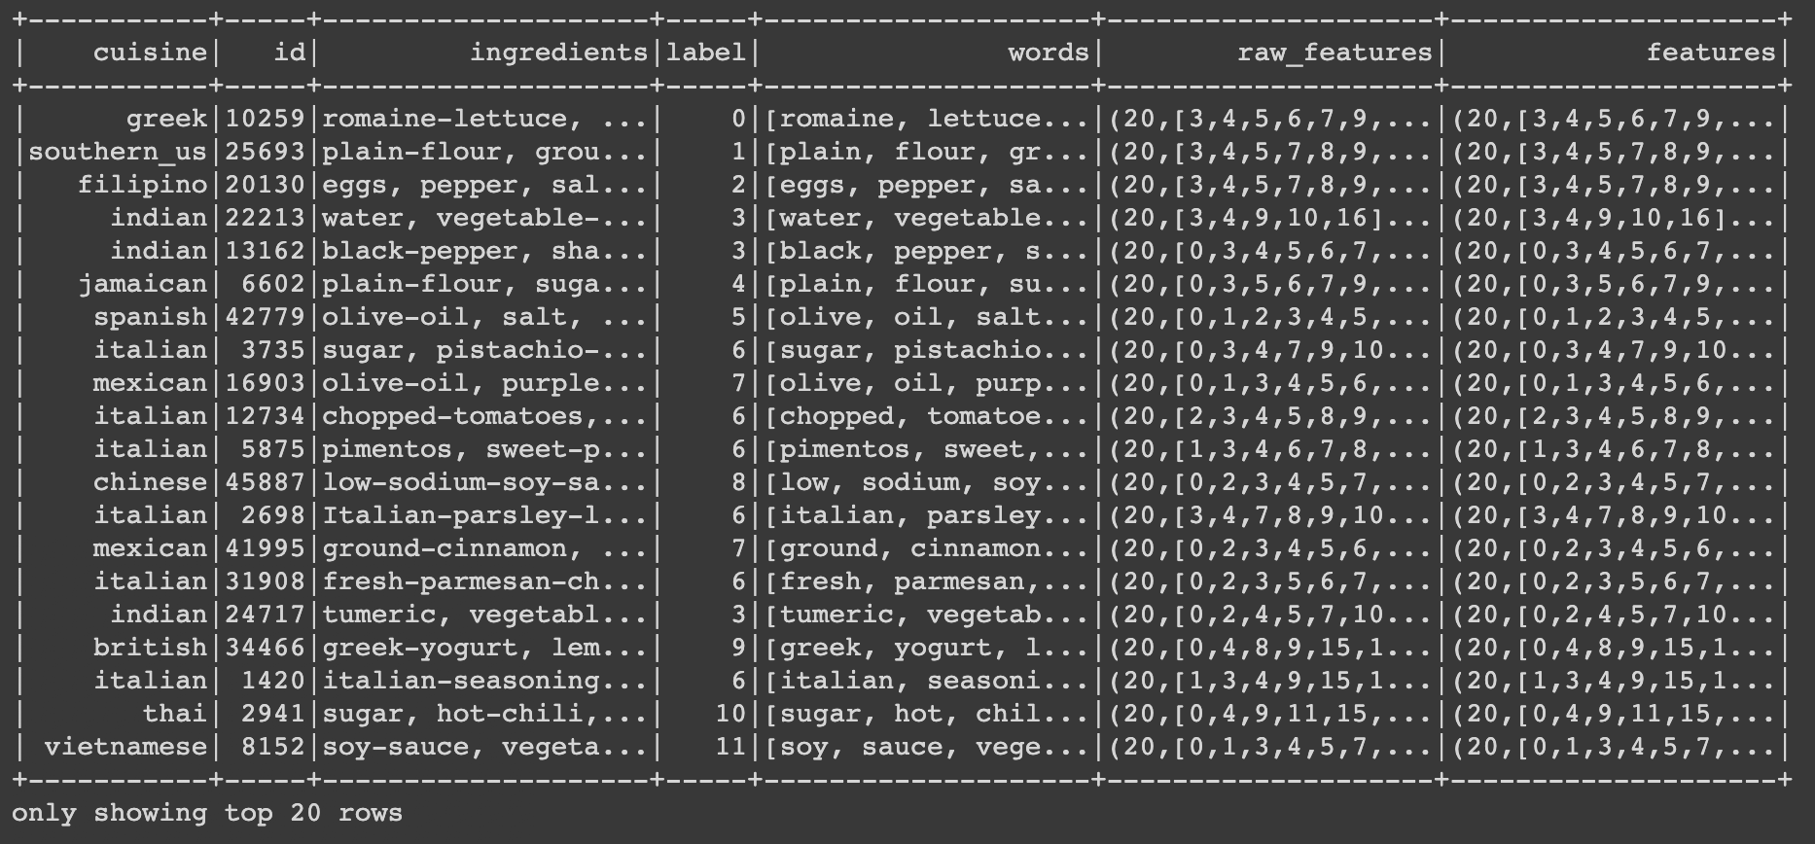
Methods – Feature Extraction
TF-IDF
Term Frequency - Inverse Document Frequency

Slide 24
Methods – Classification
One vs. Rest
Linear SVM
Logistic
Regression
Decision
Tree
Random
Forest

Slide 25
Methods – Classification
One vs. Rest
Linear SVM
two classes
20 classes
SVM 1
SVM 2
SVM 20
class 1 1
rest 0
class 2 1
rest 0
class 20 1
rest 0
......

Slide 26
Methods – Classification
Logistic
Regression
Multinomial logistic regression

Slide 27
Introduction
Data
Methods
Results
Discussion

Slide 28
Results
Accuracy Table
 | Classify | Decision Tree |  | Random Foest |  | OvR Linear SVM |  | Logistic
Extract
Word2Vec |  | 0.54726 |  | 0.66522 |  | 0.64923 |  | 0.70233
TF-IDF |  | 0.31415 |  | 0.42226 |  | 0.32693 |  | 0.37982
maxDepth = 15
maxDepth = 15
maxIter = 1000
tol = 0.001
aggregationDepth = 3
regParam = 0.01
maxIter = 1000
regParam = 0.001

Slide 29
Introduction
Data
Methods
Results
Discussion

Slide 30
Discussion
Word2Vec – Logistic Regression
Didn’t tuning parameter (CV)
Feature vector – hard to interpret, not biostatistical!

Slide 31
Thanks
Q & A

